Slide 1


Investment Portfolio
Paul Dai
July 2023
Notes:
Before we start, I want to thank you (all) for being here.
It’s my pleasure to introduce myself to you.

Slide 2
Content
Item 2- Cyclistic Bicycle Data Analysis
Item 3 - Digital Marketing KPI Tracking Dashboard
Self-introduction
1
Item 1 - LLM Application - Automatic Query Assistant
2
Item 2 - Time Series Model - Daily Sales Forecast
3
Item 3-AB Test-Purchase Card
4
Item 4 - Google Data Analytics - Cyclistic Bikes
5
Licenses and awards
6
Notes:
I’ll present for 20 mins:
First part, it’s about my background
The second part we have some project demos.
Because the limitation of our time, I think you could choose 1 or 2 case, and I’ll present that to you.
So, let me quickly go through all of them.
The 1st one is an AI model, going to predict the daily sales
The 2nd is data analysis case study, trying to find marketing strategies to enhance their members
3rd is an dashboard project, how I used AWS architecture to build dashboard.
4th is an expense reimbursements application system, that is a case I used VBA, SQL to help a start-up to build their expense application system.
Last one is an digital transformation strategies alignment, we helped a company to figure out their digital transformation blueprint.
So which one are you interested in?

Slide 3
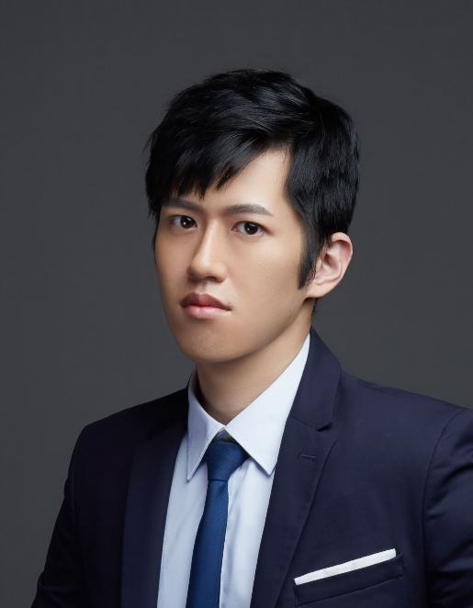

Paul Dai, Senior Data AnalystSr. Data Analyst
Work Experience (6 years+)
Skills
CTW Company (Tokyo)Senior Data Analyst
2023-Present
Automation Report (VBA)
Databases and SQL
The gift recommendation system was established through the transformer model, earning 350k JPY per day.
KPMG Digital Transformation ConsultingAssistant Manager
ML
2020-2023
DataAnalysis
DataVisualization
The leader is responsible for the development and execution of the digital transformation project for Fortune 500 companies.
Apply character grouping and data analysis to various projects to provide execution reports.
Language
Name:
Neogence cosmetics and skincare productsGeneral Manager's Special Assistant
Paul Tai
Chinese (native language)
English (TOEIC 890)
Japanese Language Proficiency Test (JLPT N2)
2017-2020
Assist the General Manager and leadership team in formulating action plans through data analysis and modeling.
Lead a team composed of junior assistants to optimize and automate processes in each department.
Position Applied for:
Data Scientist
Education
KMC Chain IND. CO., LTD(Shenzhen)Administrative Assistant
2014-2017
National Taiwan Normal University MBA
2010-2014Department of Human Resource Management, National Taiwan Normal UniversityTaiwan Normal University
Contact Information:
Phone: +81-80-6080-5242
2017
Established a cross-functional department report to monitor progress performance.
Email: paul60209@gmail.com
Notes:
I believe that I am the best candidate for this position because an excellent Data Analyst needs not only hard skills,
but also have to know how to communicate cross-dep., how to lead or encourage your team members.
During my 6 years work experiences, I started from being a MA at KMC Chain, I rotated in different dep. and work with them.
That helped me to know each dep.’s culture and what’s they desire. And, that’s my first time working in China, at 深圳.
Bcz of the health issue of my family, I went back to 台灣 after a half year. That was the second stage of my career path.
I was the special assistant to GM in the company called “Neogence”. It’s a company which dedicates to skincare and makeup market. Neogence has a self-own brand and a factory.
It’s a 7 years start-up, yearly Rev. is about 1 billion NT dollars.
My first job was to restructure the ERP system and to repair the database.
I re-defined the principle of product ID and mapped the old product ID to the new one in the database.
Next, I developed automatic program to help our colleague to key-in purchase/selling order into ERP system more efficiently.
After a year, I was promoted to “Section Chief of GMO”. I started to build my own team.
There were 3 members in my team. We built an expense application system, imported the BI tool (Qlik Sense) to establish the visualized dashboards.
I started to train my soft skills, like… divide the project scope, track timeline, ensure everyone is clear about the project purpose, and how to review each member’s performance. My team achieved many huge projects perfectly during the period.
In 2020, I was seeking for a boarder stage and wanted to work aboard but because of COVID-19, it’s risky.
Thanks for the hunter who is my friend now, he referred me to KPMG as the assistant manager of the digital transformation consulting dep.
In KPMG, I engaged in more then 10 projects as project manager (PM).
I focus on digital transformation project, which include data analysis(TA persona tagging),
dashboard building (marketing campaign dashboard),
data modeling(used car residual value prediction),
process optimization (material requirement planning)
and strategies alignment(planning the blue print of digital transformation).
About the skills:
I’m good at VBA, which is for report automation and I’m also familiar with DB and SQL. Fourth more, I have experience of data analysis and machine learning (which I will demo later.)
I’m a Chinese native speaker. Although my English is not really fluent but I’m working on improving my English and I think I could handle daily conversation with no problem.
I just passed JLPT N2 this year. If there is any occasion that needs Japanese, the company could make good use of my skill.

Slide 4
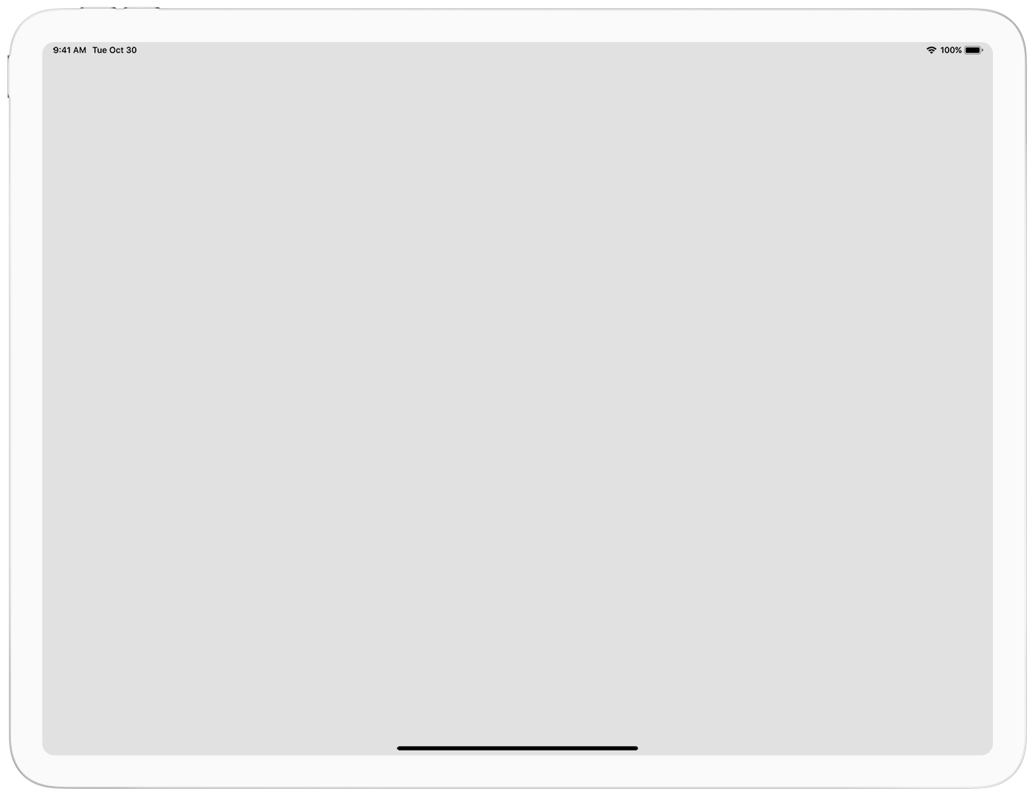
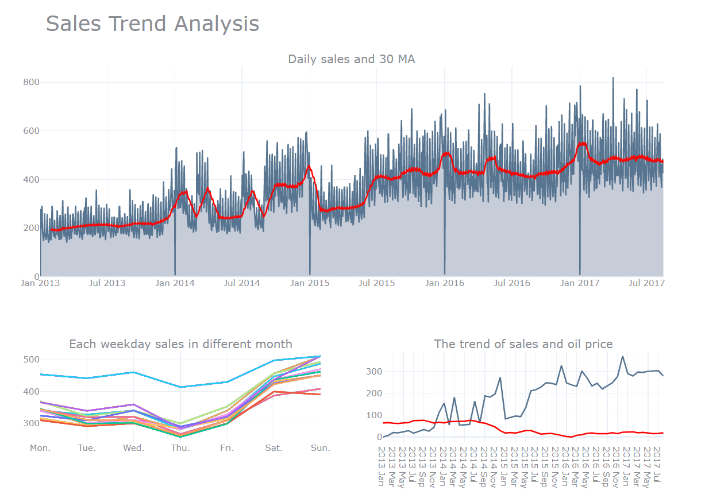

Sales Trend Analysis
Trend Analysis
Found:
The sales trend continues to increase.
Sales on January 1st every yearstAs 0.
Sales on weekends are obviously higher than on weekdays.We will use it as an exogenous variable in the following analysis.Sales in December are always higher than in other months.
Sales in Dec. always higherthan other months.
Notes:
I also made some dashboard to figure out weather is the trend or seasonal effect in our data.
There are some interesting findings.
Start from the top middle figure: It shows our sales is increasing, which means there is a trend in our data.
And, the sales on the 1st day of each year is 0.
Next, if you see the figure here, you will find sales on weekend is always higher than weekdays.

